Slide 1



Slide 2

BUSINESS ANALYTICS Introduction to Business Analytics and Core Business Functions
BUSINESS ANALYSIS PROCESS IMPROVEMENT

Slide 3

Learning Objectives – WEEK 8
By the end of today you should be able to:
Identify inefficient business processes
Perform Root Cause Analysis
Conduct Gap Analysis (AS-IS vs TO-BE)
Identify bottlenecks in workflows
Propose process improvement solutions like a Business Analyst

Slide 4
LAST WEEK
Last week we learned Process Modeling:
✔ AS-IS process ✔ TO-BE process ✔ Flowcharts ✔ BPMN
👉 Today we answer WHY the process needs improvement.
Process modeling shows the workflow. Process improvement fixes the workflow.

Slide 5
WHAT IS PROCESS IMPROVEMENT?
Process Improvement = systematic approach to improve:
✔ efficiency ✔ cost ✔ speed ✔ quality ✔ customer satisfaction
🇵🇰 Pakistan Example — Bank Loan Approval
AS-IS:
Application → Manual review → Branch approval → Central office → Approval
Time: 7-10 days.
TO-BE:
Application → Automated credit check → Approval.
Time: 2 days.
Simple Real Example
Restaurant kitchen workflow.
If chef waits for ingredients → delay.
Improvement:
Prepare ingredients earlier.
Same logic applies to businesses.
“Automation only works after process analysis.”

Slide 6
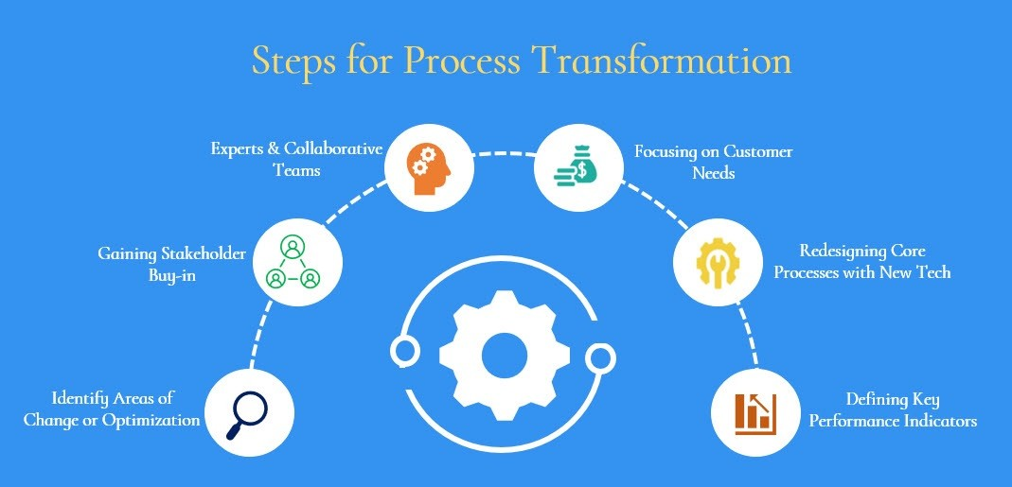

Slide 7
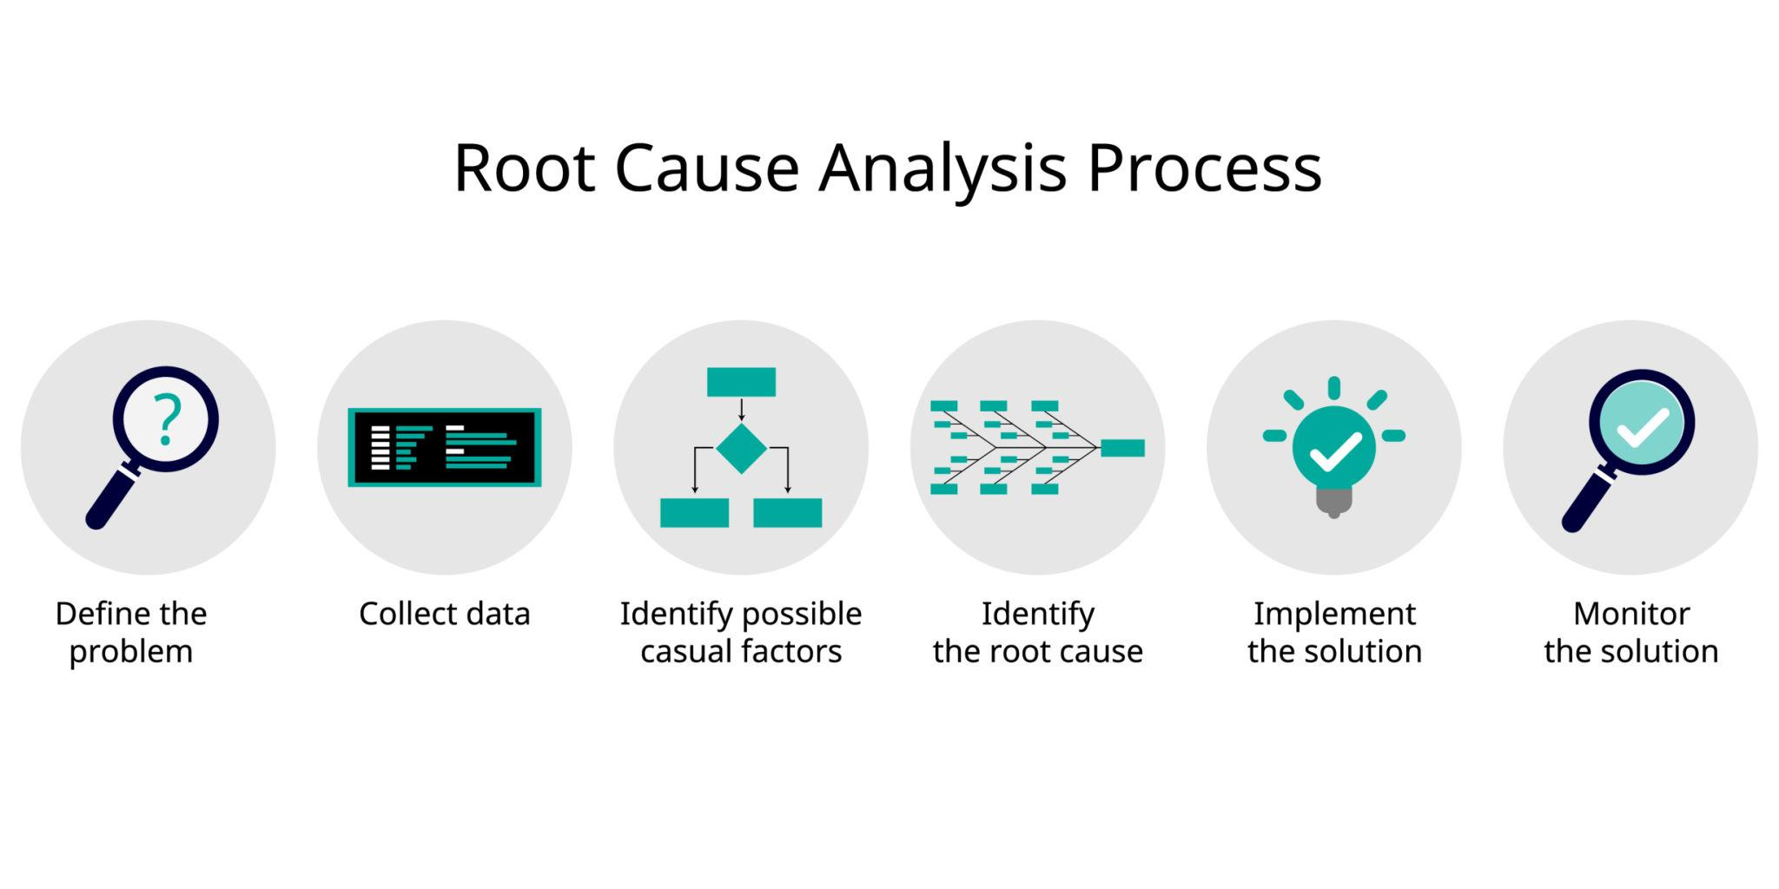
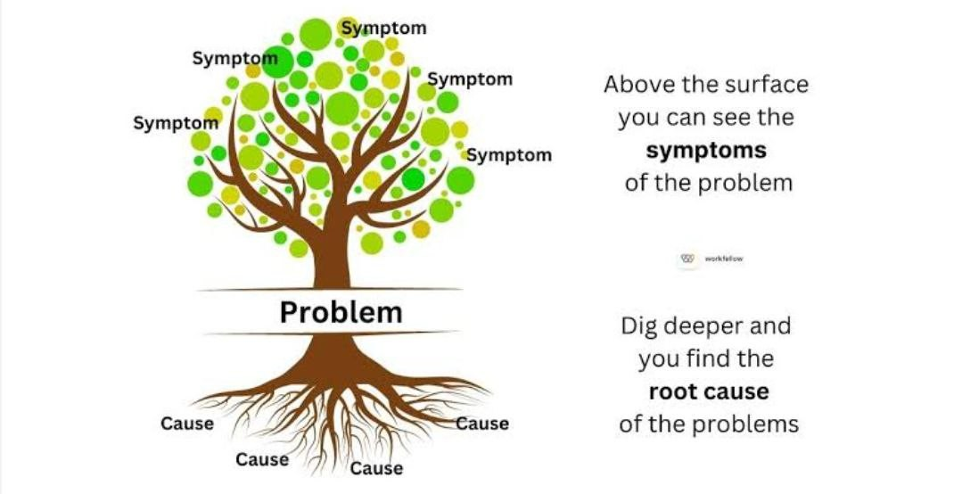
ROOT CAUSE ANALYSIS (CORE BA SKILL)
Root Cause Analysis identifies why problems occur, not just symptoms.
Example Problem
Food delivery orders are late.
Symptoms:
Customer complaints.
But what is the root cause?
Symptoms → Complaints Root Cause → Process failure
This visual helps students understand why analysis matters.

Slide 8
5 WHYS TECHNIQUE
Problem
Delivery taking too long.
Why 1
Why late?
→ Rider assigned late.
Why 2
Why rider assigned late?
→ Operations team assigns manually.
Why 3
Why manual assignment?
→ No automated system.
Why 4
Why no automation?
→ Requirements unclear.
Why 5
Why unclear requirements?
→ Stakeholder discussions incomplete.
Root Cause
Poor requirement discovery.

Slide 9
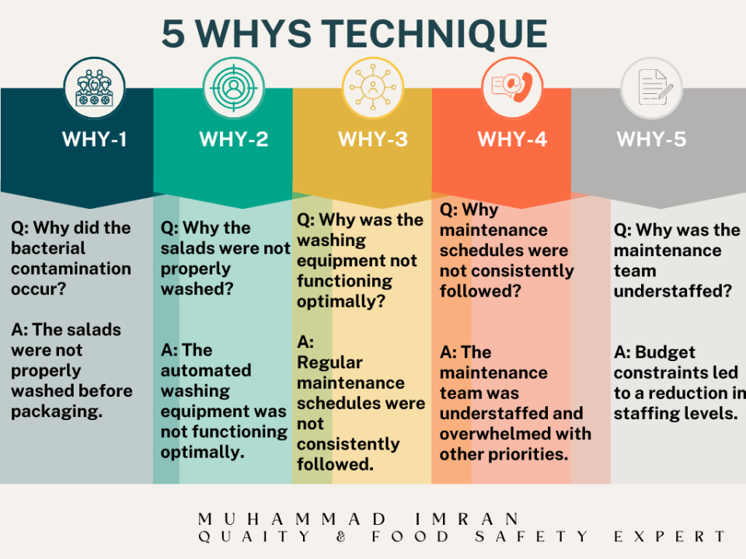

Slide 10
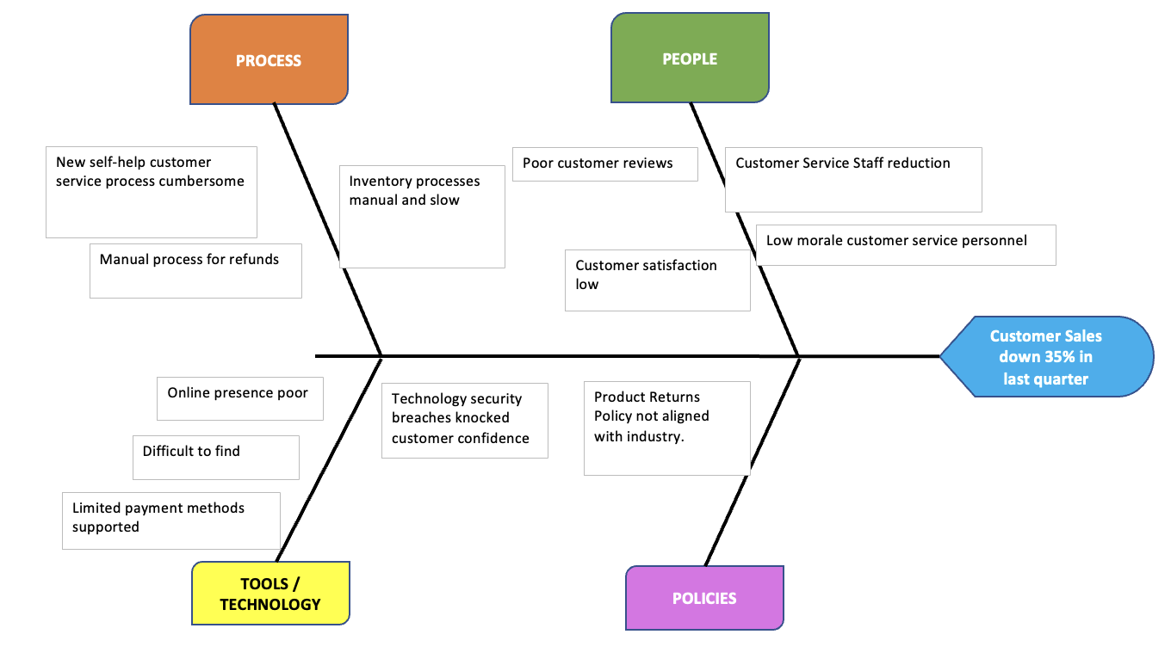
FISHBONE DIAGRAM (CAUSE-EFFECT ANALYSIS)
Example — Delivery Delays
People: Untrained riders
Process: Manual dispatch
Technology: Slow app
Explain:
Problems often come from multiple causes.

Slide 11
GAP ANALYSIS (STRATEGIC IMPROVEMENT TOOL)
Gap Analysis compares:
Current State (AS-IS)
vs
Future State (TO-BE)
Example — QuickBasket
AS-IS:
WhatsApp orders.
TO-BE:
Mobile ordering system.
Gap
Manual ordering process.
Visual Diagram
AS-IS → GAP → TO-BE

Slide 12
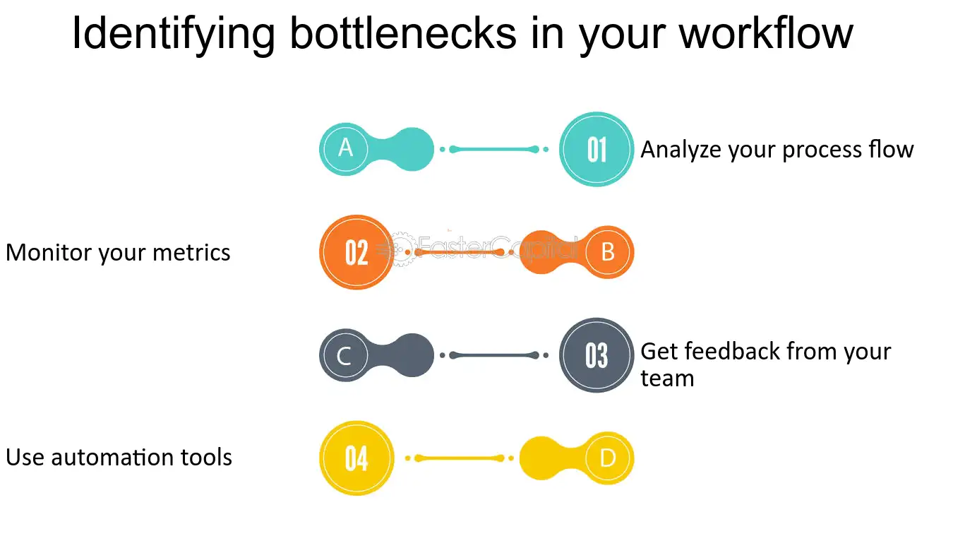
BOTTLENECK IDENTIFICATION
Bottleneck = slowest step in workflow.
Example:
Order → Payment → Assignment → Delivery ↑ Bottleneck
🇵🇰 Example — University Admission
Student → Application → Verification → Approval → Admission.
Verification step takes 3 days.
That is the bottleneck.
🌎 Example — Tesla Production
Battery assembly slowed entire manufacturing.
Improving this step increased production.

Slide 13
HOW BUSINESS ANALYSTS IDENTIFY BOTTLENECKS
Look for / Practical Indicators:
✔ long wait times ✔ repetitive work ✔ manual approvals ✔ dependency delays
Instructor Example
In software projects:
Design approval delays development.
Design stage becomes bottleneck.

Slide 14
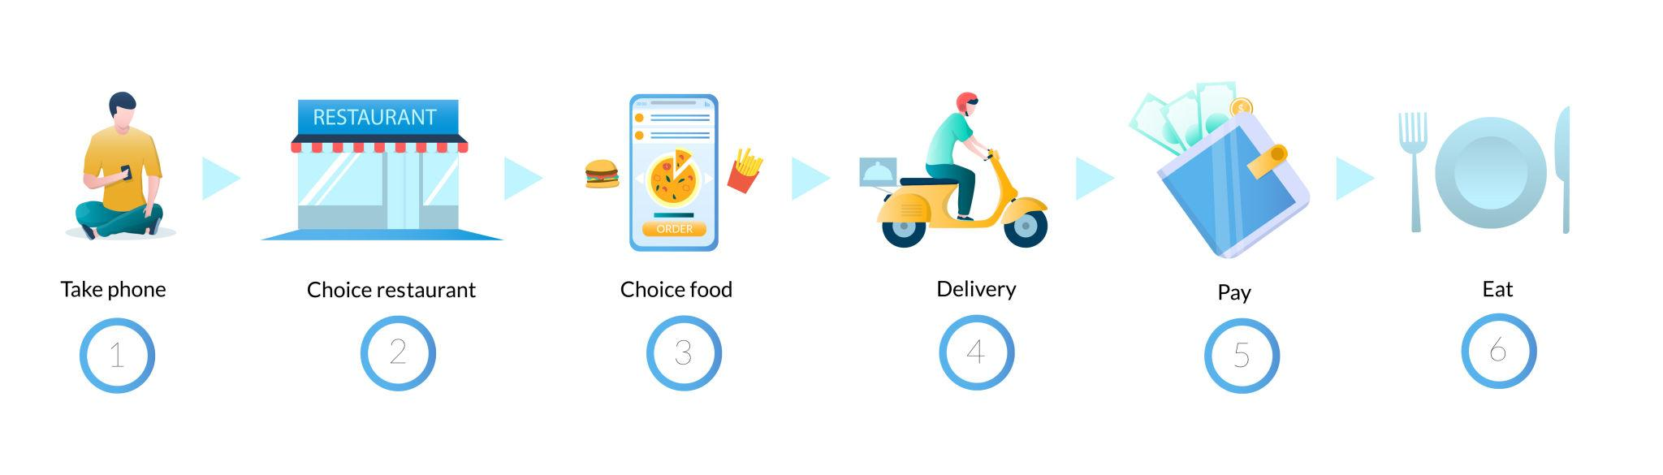
CASE STUDY
Scenario:
QuickBasket Delivery System.
AS-IS:
Customer order → Ops assign rider → Rider delivers.
Students identify:
✔ Root cause ✔ Bottleneck ✔ Improvement.

Slide 15
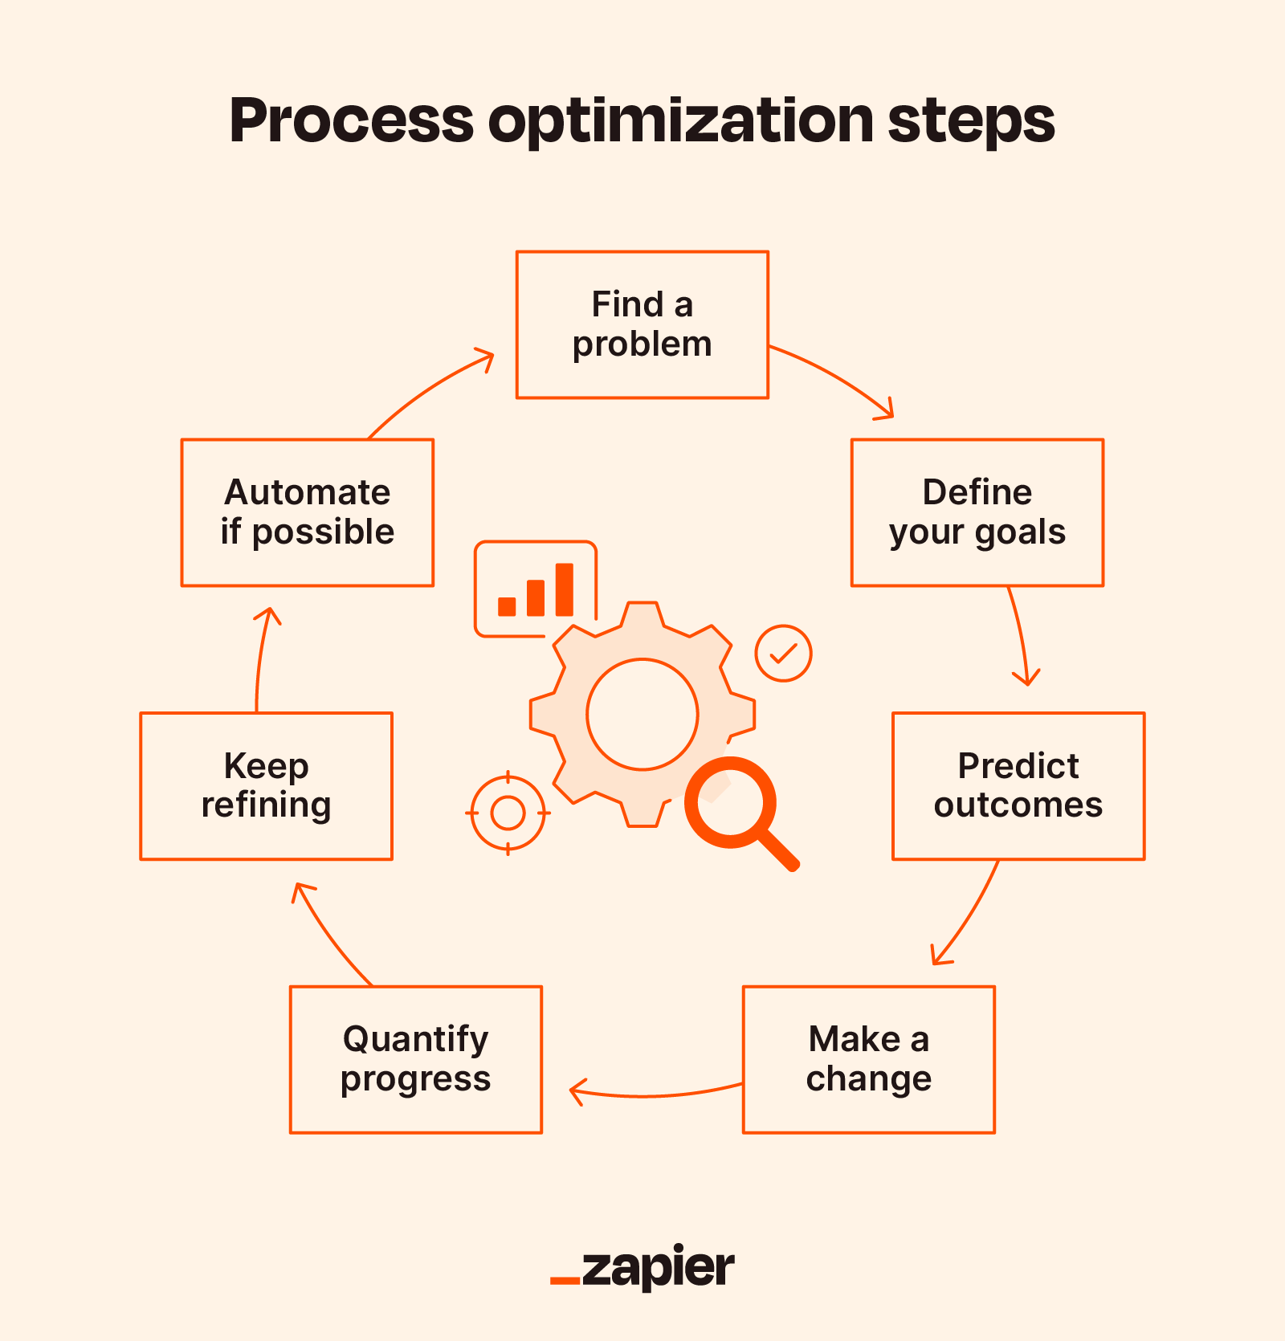
PROCESS IMPROVEMENT TECHNIQUES
1️⃣ Automation
Example:
Online payments replacing manual cash.
2️⃣ Simplification
Reduce unnecessary steps.
Example:
3 approval layers → 1 approval.
3️⃣ Parallel Processing
Multiple tasks happen simultaneously.
Example:
Payment verification while preparing order.
4️⃣ Standardization
Create consistent workflows.
Example:
Customer service scripts.
Industry Example (Relatable)
Uber driver matching.
Old process:
Manual dispatch.
New process:
AI auto matching.
Improvement:
Faster ride allocation.

Slide 16
COMMON MISTAKES STUDENTS MAKE
❌ Jumping to tech solutions immediately.
❌ Ignoring human workflow.
❌ Fixing symptoms instead of root causes.
Teach:
First analyze process → then improve.

Slide 17
LINK TO DATA ANALYTICS (PREVIEW WEEK 9)
Explain:
Process improvement relies on data.
Examples:
Delivery time
Order volume
Customer complaints
Analytics reveals bottlenecks.
Next week students learn this.

Slide 18
CLASSROOM WORKSHOP
Divide class into groups.
Scenario:
University course registration.
Students must:
✔ Identify bottleneck ✔ Perform 5 Whys ✔ Suggest TO-BE process.
“What step takes longest?”
“Can tasks run in parallel?”

Slide 19
KEY TAKEAWAYS
✔ Root Cause Analysis identifies real problems ✔ Gap Analysis guides transformation ✔ Bottlenecks slow entire process ✔ Process improvement increases efficiency ✔ Business Analysts drive operational optimization

Slide 20
“Many companies automate broken processes — which only makes problems faster.”
“Process improvement often costs less than building new technology.”
“The best BAs solve problems before they become expensive.”

